Slide 1


Minor Project
Prospective vote bank identification using Sentimental Analysis
Presented by:
R2142220659 -Shubh Dulwani

Slide 2
Content
Introduction
Literature Review
Objectives
Methodology
Working Model
Results
Conclusion
References

Slide 3
Introduction
Sentimental Analysis is a method used to judge someone’s feelings or make sense of their feelings according to a certain thing.
It is basically a text processing technique and aims to determine the class that the given text wants to express emotionally.
During election campaigns and elections, both contesting parties and voters express their opinions on social media websites generating huge amount of semi structured data.
Sentiment analysis focuses on the polarity of a text (positive, negative, neutral)

Slide 4
Algorithms Used
Polarity-Based Sentiment Analysis using Text Blob (Naive Bayes-based)
The application uses Text Blob's built-in sentiment analysis, which assigns a polarity score ranging from -1 (negative) to +1 (positive). It analyzes cleaned text data using a pre-trained Naive Bayes classifier or pattern-based model to determine sentiment orientation (Positive, Neutral, Negative).

Slide 5
Motivation
Elections are a significant component for any democratic country which involves the expression of opinion using a vote. People also express their opinions on social media regarding elections. The 2024 U.S. election was controversial since allegations of rigging and result manipulations surround it. Using sentiment analysis this project reveals several hidden aspects of public opinion for different parties and candidates and would unleash similar sentiments for a given state.

Slide 6
Problem Statement
To analyze winning candidate from 2024 presidential Election tweets given in the dataset.

Slide 7
Area of Application
Sentimental analysis is the automated process of analyzing text to determine the sentiments expressed (positive, negative or neutral).The applications of sentimental analysis are endless and can be applied to any industry, from finance and retail to hospitality and technology such as market research, social media monitoring, vote bank identification, customer support management and analyzing customer feedback.

Slide 8
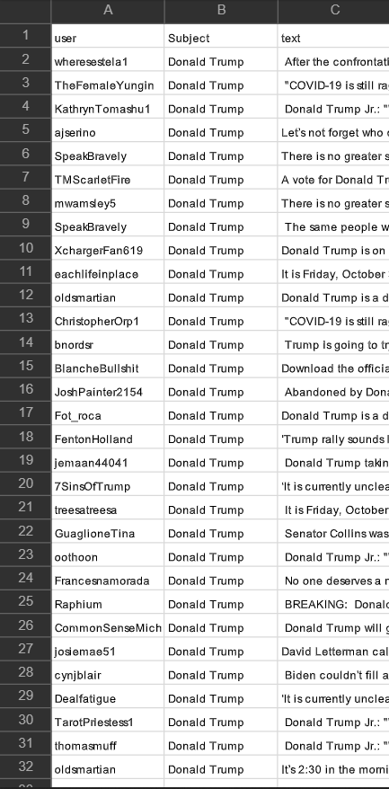
Dataset Used
Dataset- The US Presidential Elections 2024
Source- https://docs.google.com/spreadsheets/d/15rCe4i8M6Z-3cWzCcSHjWaqyCBslAu50wzB-8e3xIkE/edit?usp=drive_link
Format- csv file

Slide 9
Literature Review
The research paper by Balika J. Chellia, Kartikaya Srivastava, Jishnu Panja, Ritwik Paul named “Sentiment Analysis of Twitter for Election Prediction” briefs about a model for the better prediction that will help in the analysis of voting choices of users, to increase the validity of the final results, various refining techniques have been used so that only relevant tweets are analyzed.
The research paper named “Using sentiment analysis to define twitter political users’ classes and their homophily during the 2016 American presidential election” written by Josemar A. Caetano, Hélder S. Lima, Mateus F. Santos & Humberto T. Marques-Neto briefs the three non-supporter classes are defined like Positive, Neutral, and Negative as classes that have users expressing positive, neutral, and negative sentiment towards both candidates, respectively on a dataset consisting of 4.9 million tweets published by 18,450 users, their profiles and their relationships with other users.

Slide 10
SWOT Analysis
Strength-
Simple, and fast sentiment analysis using Text Blob
Easily processes CSV files and generates and generates visual insights(charts & summaries)
Weakness-
May misclassify neutral or ambiguous text
Cannot handle non- English or multilingual datasets without customization
Opportunity-
Can be extended to support real-time tweet streaming via Twitter X API
Scope to train a custom ML or DL model for better sentiment classification
Threat-
Presence of bots , paid users , or propaganda can skew real sentiment
Sudden changes of public opinion might not reflect immediately

Slide 11
Objective
To design or develop a model website to identify different sentiments of vote bank on the basis of positive, neutral and negative feedbacks.

Slide 12
Methodology
Collection of data:
People express their opinions on these forums with different vocabulary, writing context, slang which makes data huge and unorganized. Hence, various programming languages like Java are used for processing and analyzing the data. We are using .csv tweet files.
Preparation of text:
The words considering one at a time we will check whether they are present in the list of stop words or not. If it is present in the stop word that word is ignored and code moves on to the next word.
Detecting the sentiment:
The score of a word will be fetched and added to the score.

Slide 13
Sentiment Detection:
We use Text Blob, a rule-based NLP library, to calculate the sentiment polarity score of the cleaned text. This score is then categorized as:
Positive
Neutral
Negative
Visualization and Interpretation:
The categorized sentiment results are summarized and visualized through:
Pie charts (sentiment distribution)
Histograms (sentiment score frequency)
Text-based summaries (prediction and insight)

Slide 14
Collection of Data
Cleaning of Datasets
Download Tweets using twitter API
Datasets
Tokenize
Opinion word extraction
Or Download Dataset
Stop words Removal
Sentimental Analysis
Accuracy Calculation and Comparison
Polarity Determination
Result Visualization

Slide 15
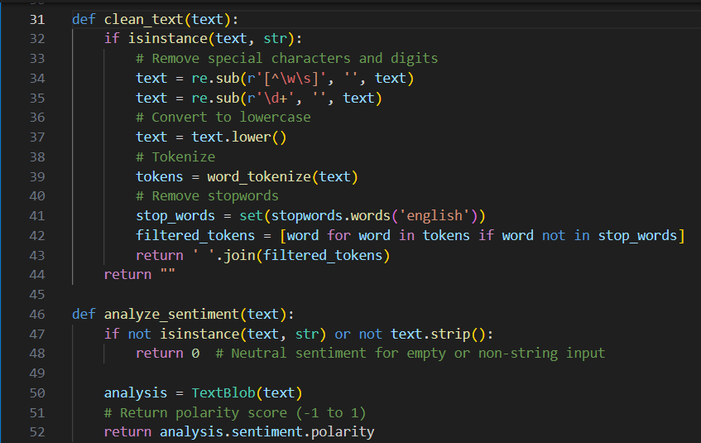
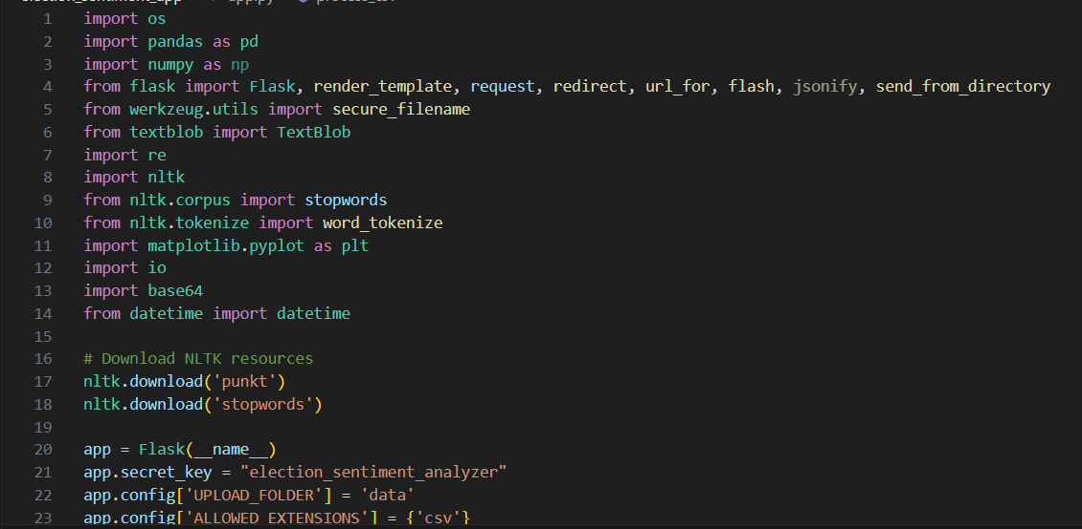
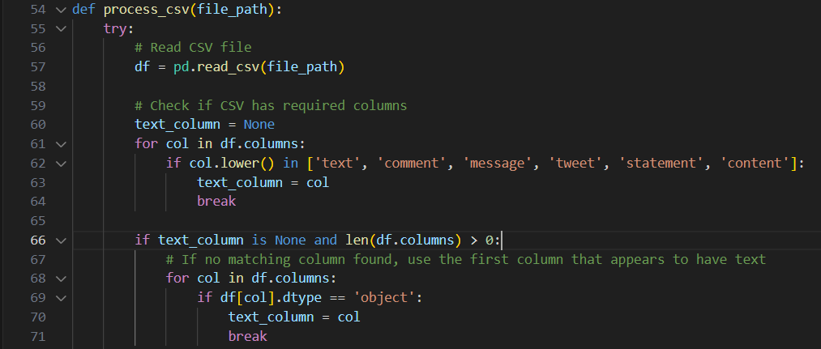
CODE SNIPPETS

Slide 16
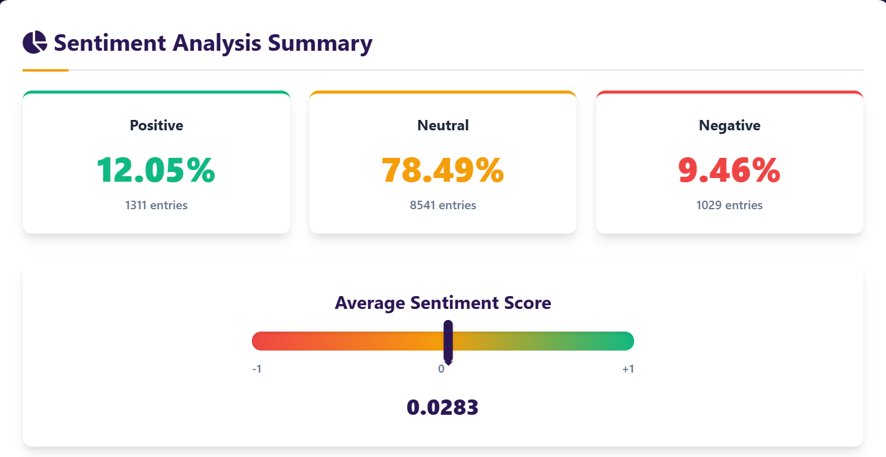
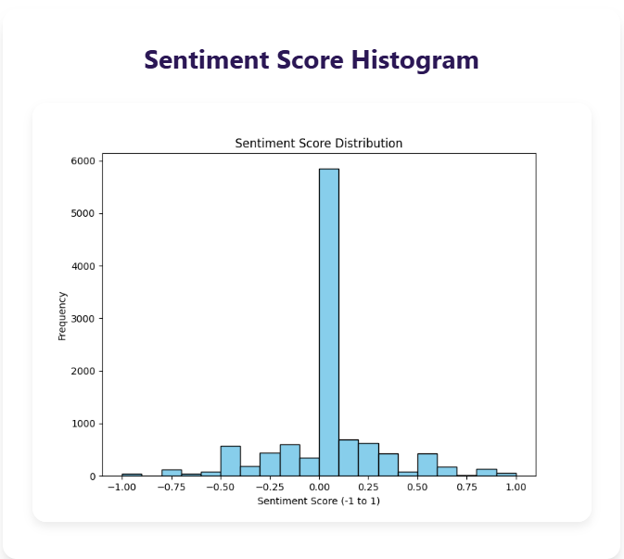
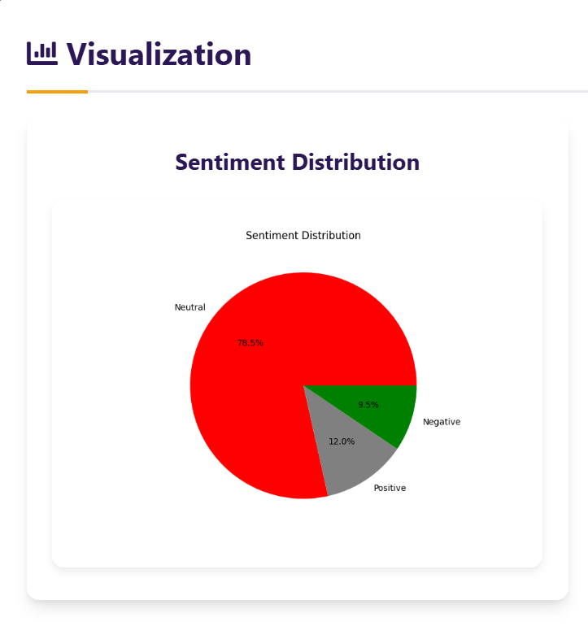
RESULT

Slide 17
CONCLUSION
Out of the total tweets analyzed, the majority (78.49%) were neutral, while 12.05% expressed positive sentiment and 9.46% expressed negative sentiment. The average sentiment score was 0.0283, indicating an overall slightly positive sentiment trend among the tweets.

Slide 18
Reference
https://towardsdatascience.com/sentiment-analysis-on-twitter-data-regarding-2020-us-elections-1de4bedbe866
https://github.com/PritamGuha31/Sentiment-Analysis-on-Twitter-data-ahead-of-2020-US-Elections/blob/main/README.md
https://www.geeksforgeeks.org/twitter-sentiment-analysis-using-python/
http://www.meng-jiang.com/pubs/crossmedia-heteronam18/crossmedia-heteronam18-paper.pdf
https://www.youtube.com/watch?v=-D2AaOXMCuc&ab_channel=IvyProSchool

Slide 19
Thank You

